Slide 1
School Information System
M Hudya Ramadhana
Mutia Ayu Dianita
Radityo Harimurti

Slide 2
Content
Background (Radit)
System Analysis (Radit)
Attributes (Radit)
Entities Relational Diagram (Mutia)
Tables (Mutia)
Normalization (Kiddy)
Tables After 1NF (Kiddy)
Tables After 2NF (Kiddy)
Mapping Table Method (Mutia)

Slide 3

Background

Slide 4
System Analysis
System Summary
System Process

Slide 5
Attributes
ENTITIES | ATTRIBUTES
Student | Id_student
 | Password
 | Name
 | Sex
 | Birthdate
 | Address
 | phone
Class | Id_class
 | Name
 | Id_headclass
Parents | Name
 | Address
 | Phone

Slide 6
Attributes
ENTITIES | ATTRIBUTES
Majoring | Id_majoring
 | Name
Course | Id_course
 | Name
Teacher | Id_subject
Employee | Id_employee
 | Password
 | Name
 | Sex
 | Birthdate
 | Address
 | Phone

Slide 7
ENTITIES RELATIONAL DIAGRAM
CLICK

Slide 8
TABLES
Student
Id_student
Password
Name
Sex
Birthdate
Address
Phone
Employee
Id_employee
Password
Name
Sex
Birthdate
Address
Phone
Parents
Name
Address
phone
Majoring
Id_majoring
Name
Class
Id_class
Name
Id_headclass
Teacher
Id_course
Course
Id_course
Name

Slide 9
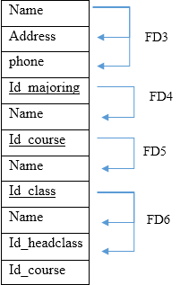
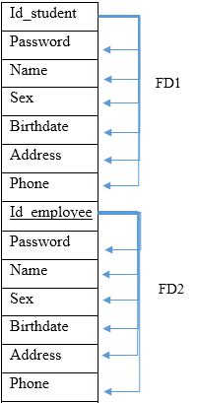
NORMALIZATION
ABNORMAL TABLE

Slide 10
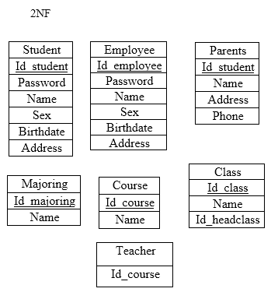
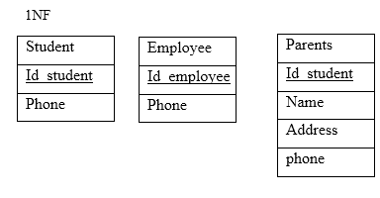
NORMALIZATION

Slide 11


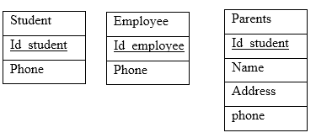
TABLES AFTER 1NF

Slide 12
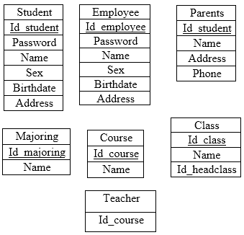
Tables After 2NF

Slide 13
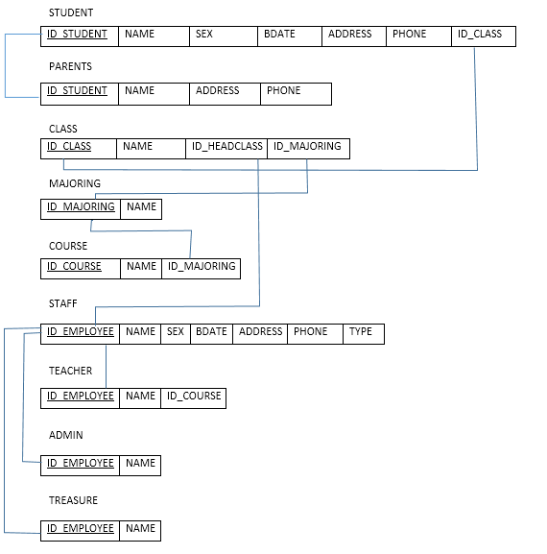
MAPPING TABLE METHOD

Slide 14
THANKS FOR YOUR ATTENTION

